Slide 1
Finding The Right Bud
EDA 1 - 2023 Lani Lewis SMU

Slide 2
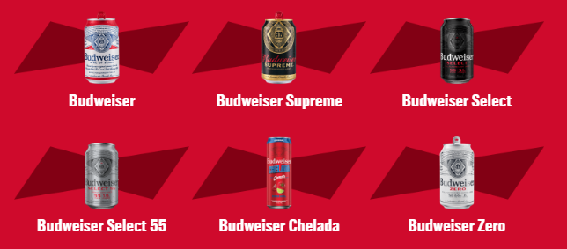
Budweiser Beer
“Budweiser is a medium-bodied, flavorful, crips American-style lager.”
5% Alcohol by Volume (ABV)
12% International Bitterness Units (IBU)
https://us.budweiser.com/
https://worldfood.guide/list/list_of_beers_in_america_by_alcohol_content_abv/

Slide 3
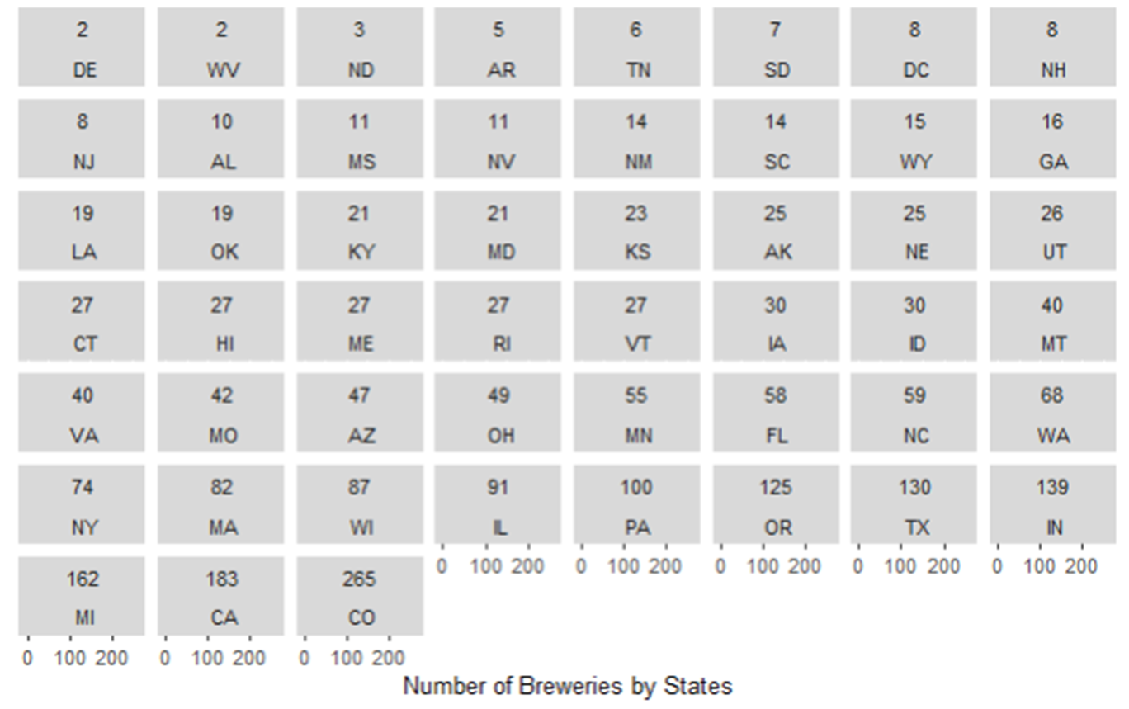
Understanding State Expansion

Slide 4
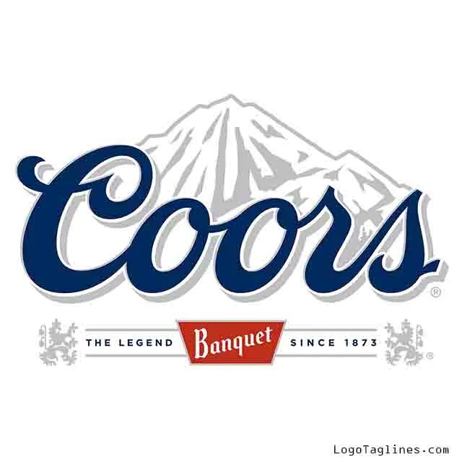







Colorado Beer History

Slide 5
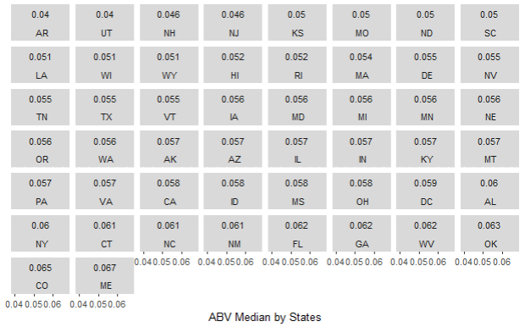
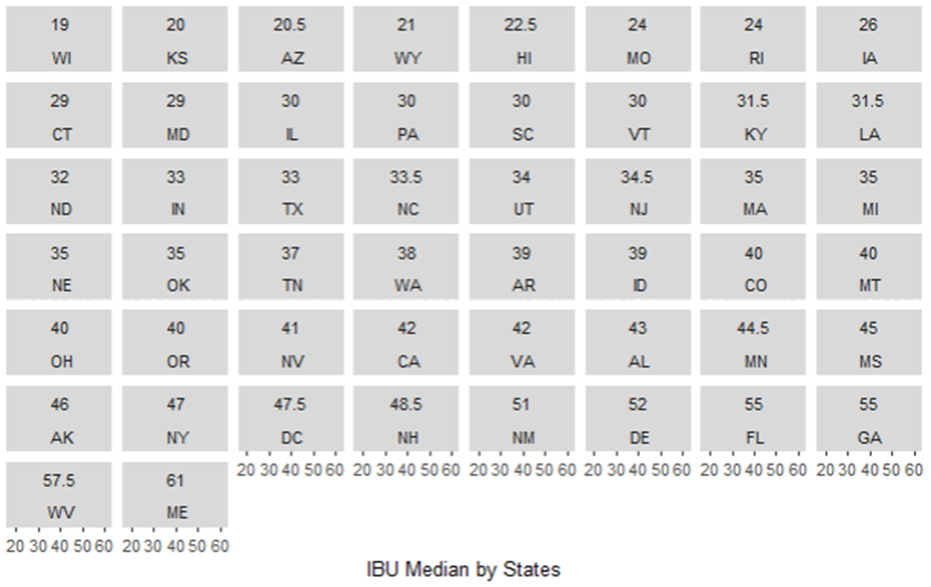
Maine Highest ABV or IBU Median

Slide 6
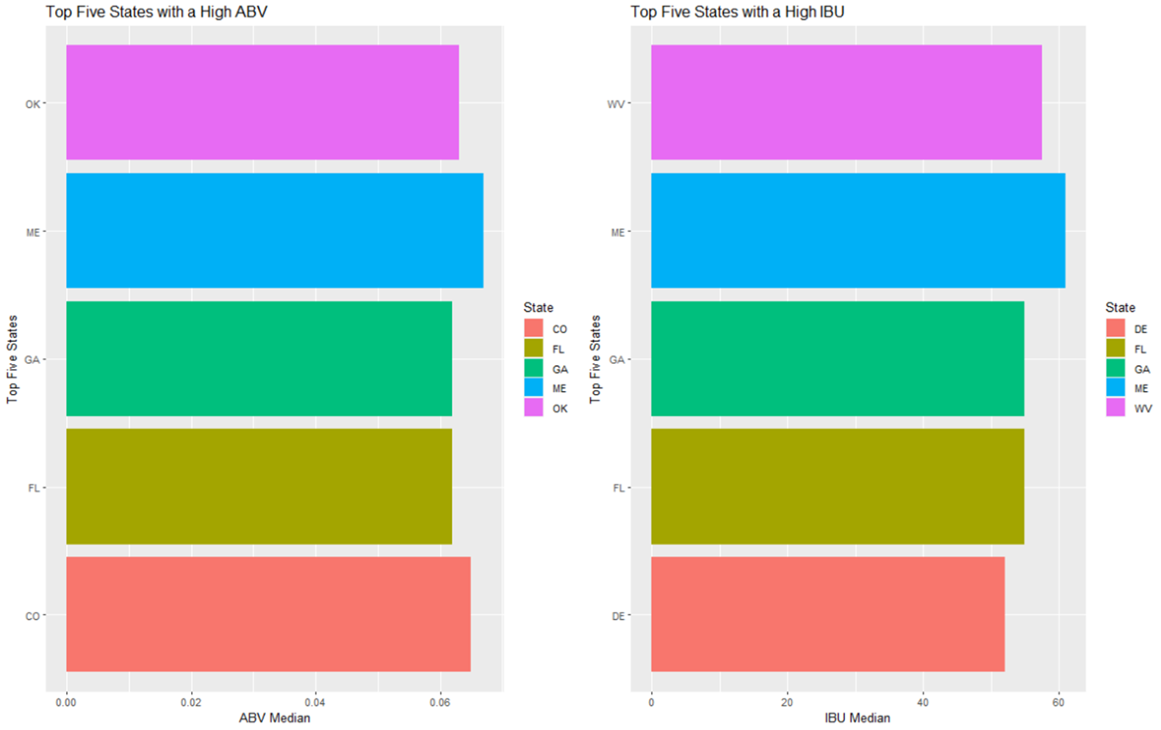
Top Five States by ABV or IBU

Slide 7
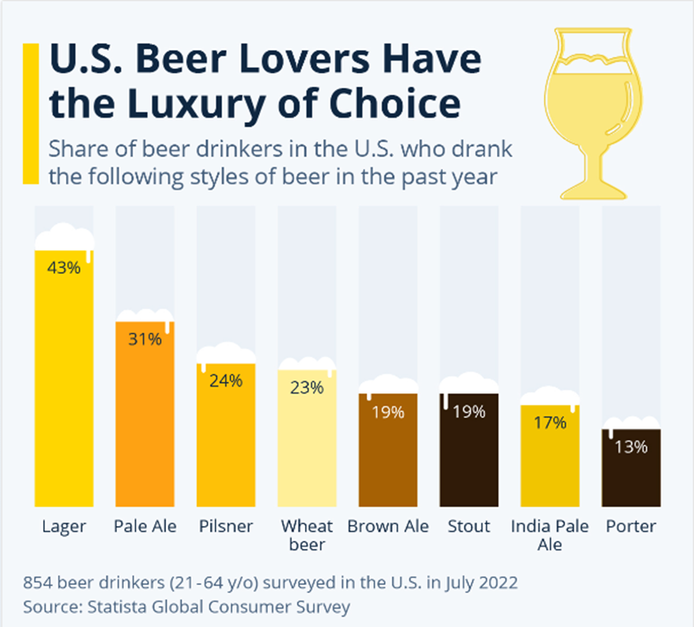
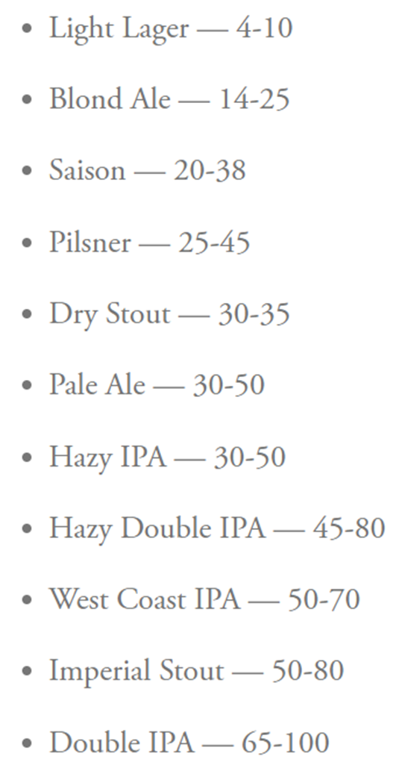
US Beer Type of Choice
IBU By Beer Type
https://www.statista.com/chart/28572/popularity-of-beer-styles-in-the-us/
https://www.firestonebeer.com/what-really-is-ibu/

Slide 8
MAX ABV & MAX IBU
MAX ABV: 52 Lee Hill Series Vol. 5 - 12.8% ABV Boulder , CO
MOST BITTER: 375 Bitter Bitch Imperial IPA 138 IBU Astoria OR

Slide 9
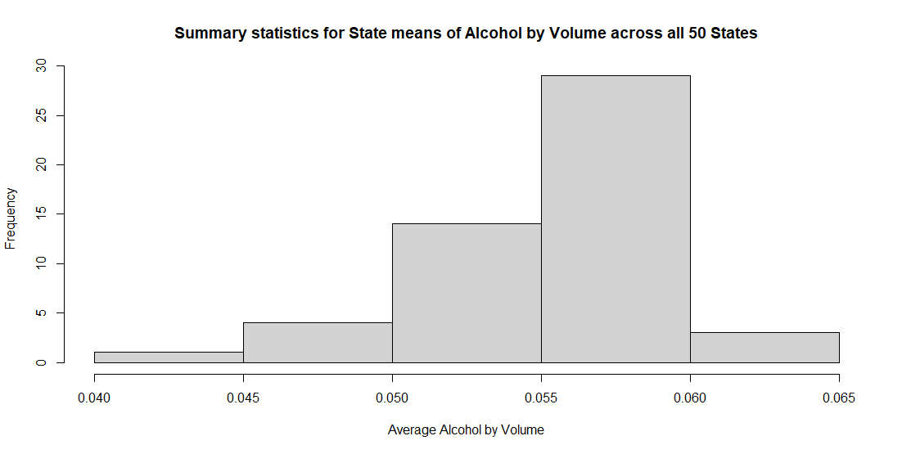
Summary Statistics and Distribution by ABV
Comments on summary statistics and distribution Alcohol by volume for beers – not grouped
MIN: 0.10%
MAX: 12.8%
MEAN: 5.977%
MEDIAN: 5.7%

Slide 10
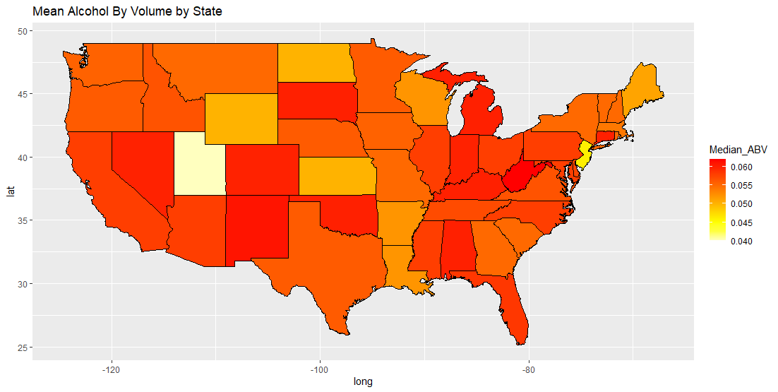
Mean Alcohol by Volume by State

Slide 11
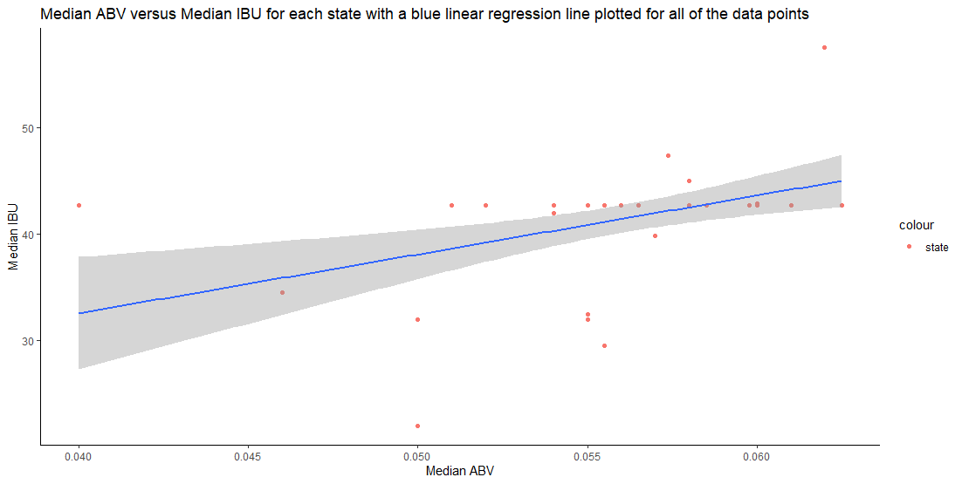
Relationship between ABV & IBU

Slide 12
Thank You For Your Business!
Lani Lewis & Todd Garner
DS 6306 Case Study 1 - EDA

